Slide 1

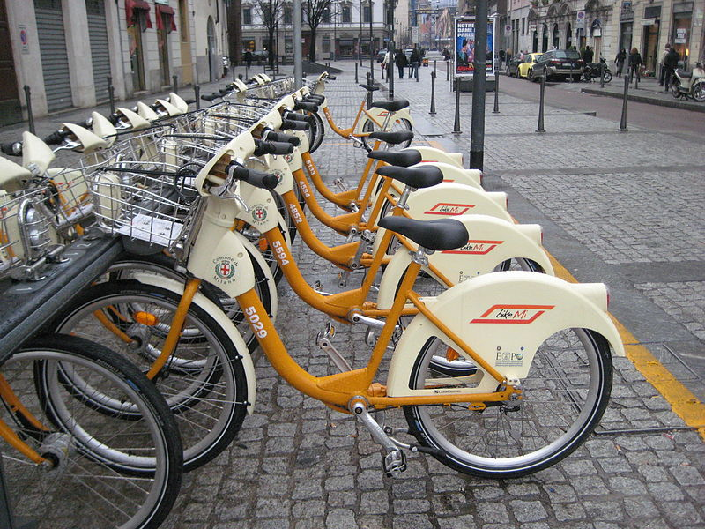
Instructor: Prof. Daya Rudhramoorthi -By Group 2 Priyanka Nagesh Adiga Sindhusha Karra Anubhav Saha Roshni Vadiraja
Analysis on Bike Sharing Washington D.C

Slide 2
Index
Introduction
Goals and Objectives
Initial Data analysis
Data Visualization
Model Formulation
Results
Conclusion

Slide 3
Introduction
Today more people are opting for environmentally friendly and healthy ways of transportation and riding a bike to the workplace or school is the best option for a lot of people to live healthy and eco-friendly.
As more people are preferring bike sharing option, there is an increase in the market space for such companies.
It important to look closely at the data and identify the renting habits of people in order to make the rental process more attractive to potential customers and increase the overall revenue.

Slide 4
Goals and Objectives
In this Project we aim to determine the correlation of environmental factors like the weather conditions, season, time of the day, day of the week, etc. with the bike rental behavior of the public.
The results from this analysis to determine a strategy to promote the usage of bike sharing for both the casual and registered users, whilst also aim at converting the casual users into registered ones.

Slide 5
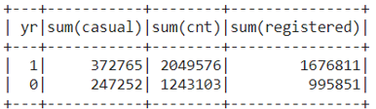
Initial Data Analysis
Our dataset consists of two different csv files, namely hour and day csv. The day dataset consists of 731 records with a total of 16 columns, whereas the hour dataset consists of 17379 records with a total of 17 columns, the additional column being the hour of the day.
Below is a summary of registered and casual users

Slide 6
Data Visualization

Slide 7
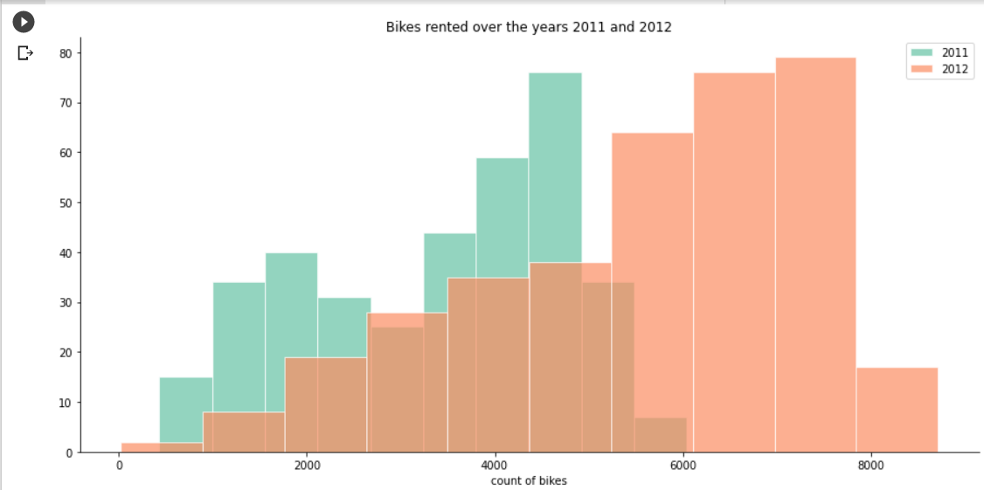
Bike Rented Over the years 2011 and 2012
The graph clearly shows us that the number of bike rentals have gone up significantly from the year 2011 to 2012.

Slide 8
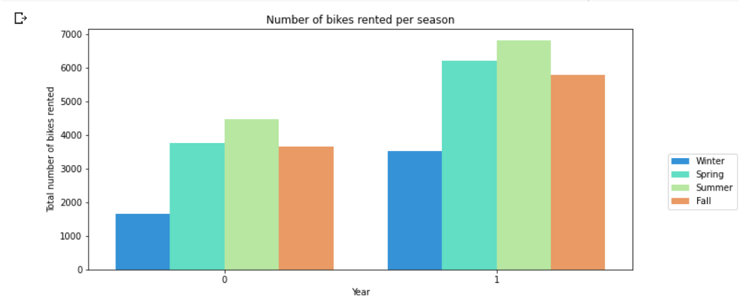
Bikes Rented Over the years 2011 and 2012
The graph helps us view the number of bikes rented across the two years segregated by different seasons to get a sense of the popularity of seasons.
We can notice that the number of bike rentals is the least during winter, which makes sense because of extreme cold winters across the Northeast.
Summer seems to be the most popular season in both 2011 and 2012 as the weather is usually nice and warm which is suitable for outdoor activities.
Fall and Spring are neck to neck in both these years, with Spring slightly having the edge.

Slide 9
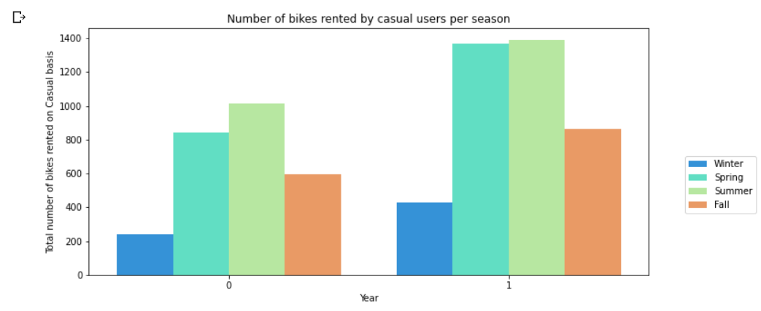
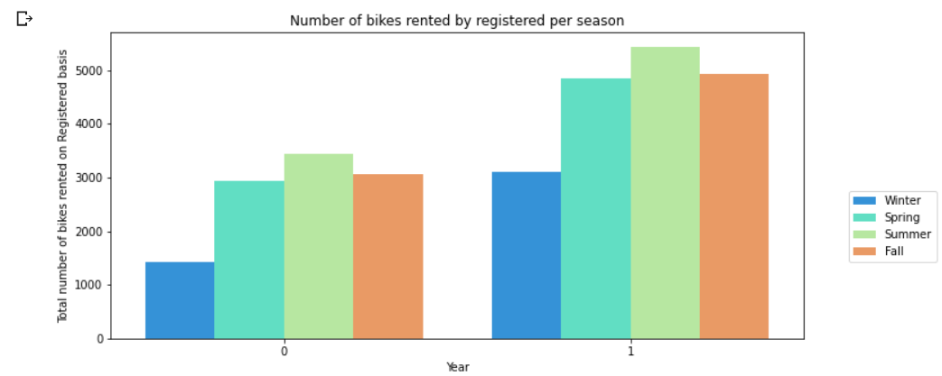
Bikes Rented by Casual Users and Registered
From the first graph we can notice a rising trend of rentals on the year 2012 compared to 2011, more significant rises occurring in the seasons of spring and summer.
In this second graph we can see an overall rising trend with the seasons of Spring and Summer seeing a steep rise. The major difference compared to the casual users being the significant updraft of the Fall bar as well, indicating the number of registered users increased in the Fall more proportionally than the casual users.

Slide 10
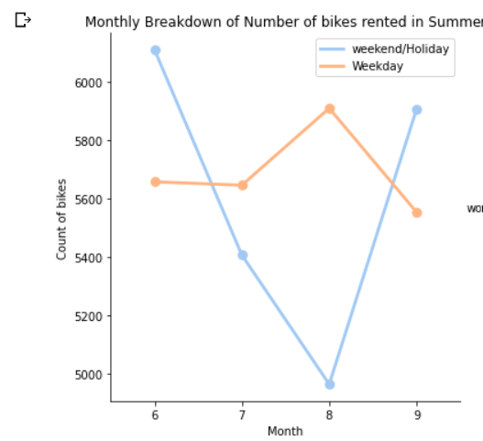
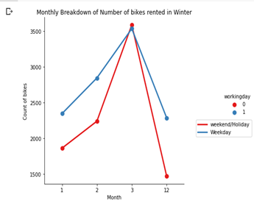
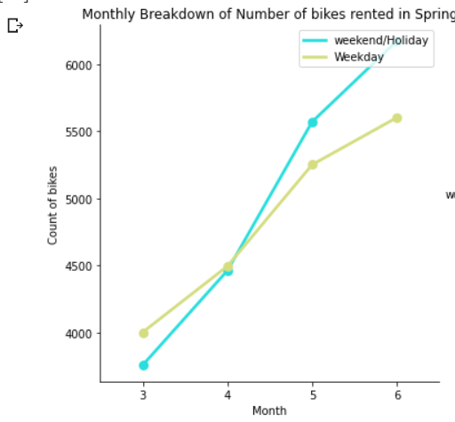
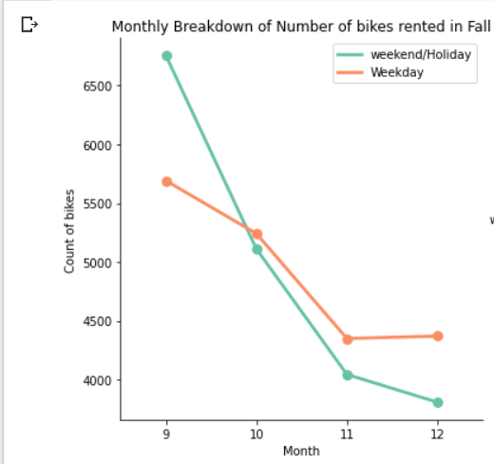
Impact of Season on Bike Rentals
From the graph of the summer season above, we can see the rental trend of weekend/holiday falling till the month 8 and then rising again during after that, and the opposite trend on the weekday.
For the graph of the Winter season, the number of rentals is higher during weekends or holidays compared to the bike rentals weekdays.
From the two graphs above, we can see opposite trends, while the renting rises on the spring season on both weekends and weekdays, it falls at a similar pace during the Fall season.

Slide 11
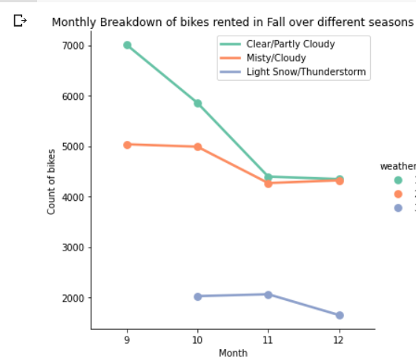
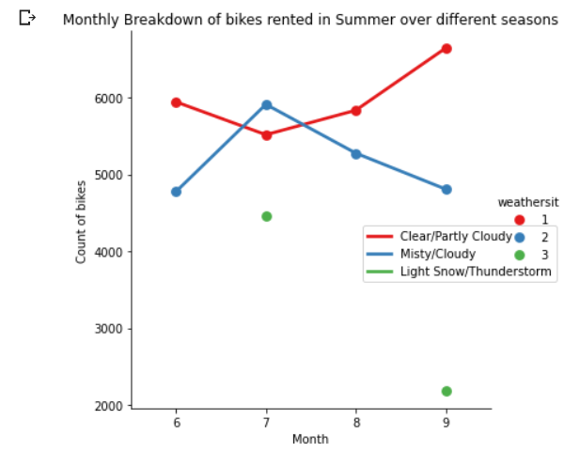
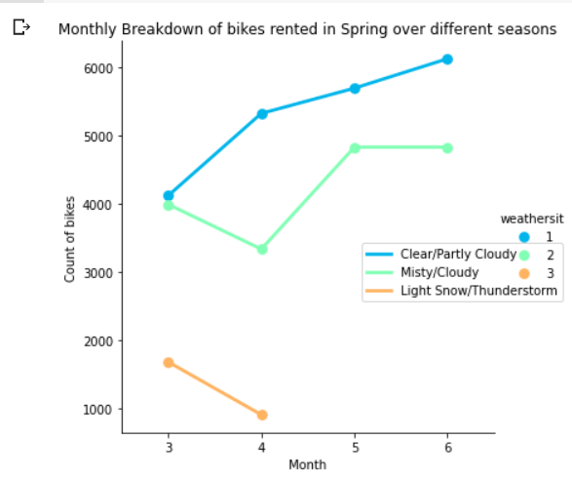
Impact of Weather on bike rentals
From the graphs above, we can see that the renting trends more strongly correlate to the weather than the seasons themselves as renting goes up during clear skies and falls during thunderstorms.
This supports our hypothesis that people prefer renting bikes more when there are clear skies and they don’t prefer raining when there’s thunderstorms or heavy rains.

Slide 12
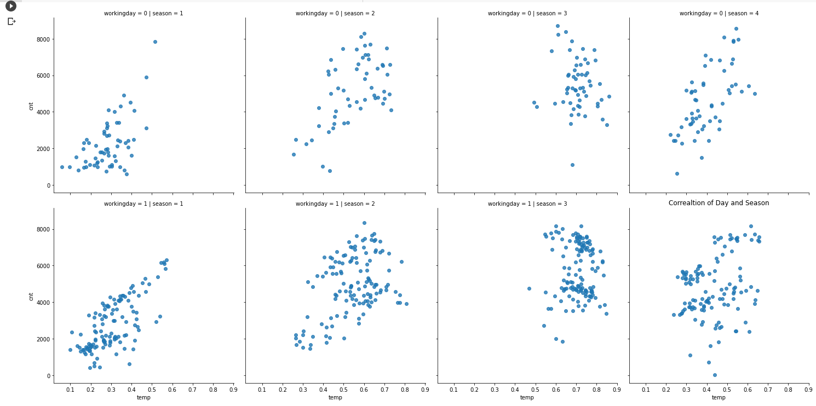
Impact of Temperature on Bike Rentals
The following graph helps us to identify the ideal temperature for bike rentals, irrespective of the seasons or the weather conditions.

Slide 13
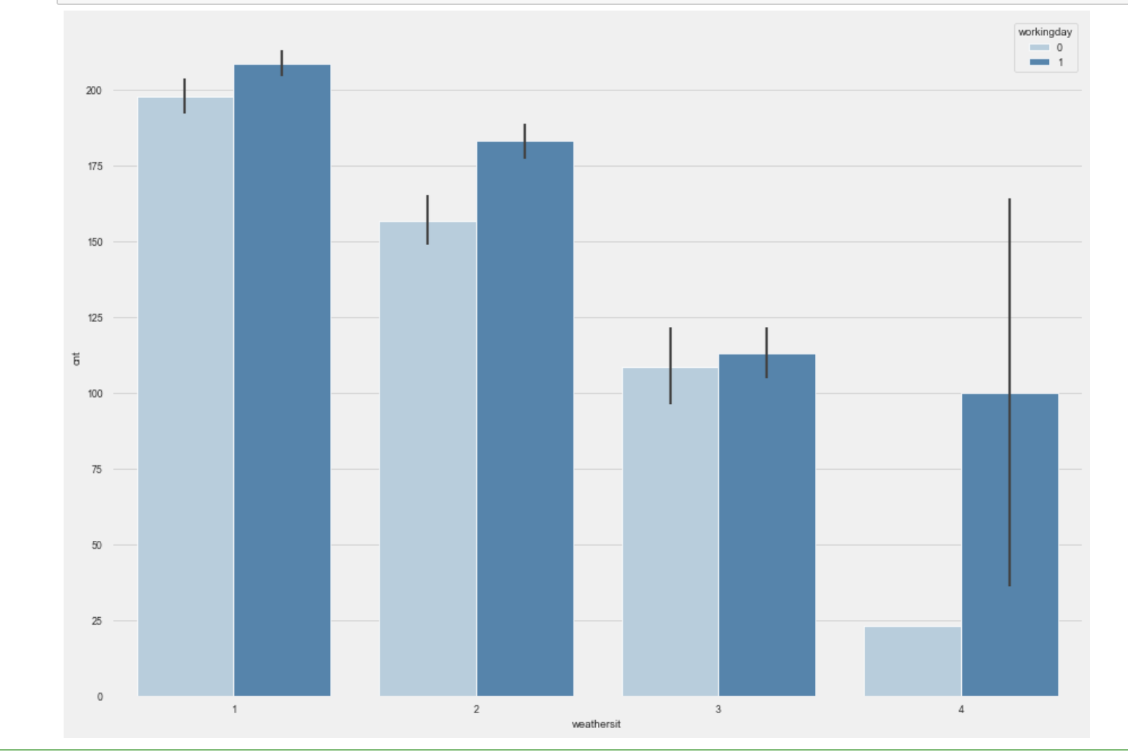
Impact of Holiday and Weather
The darker blue bar indicates the working days, and the lighter blue showcases the holidays. The variable weathersit is coded as 1 being clear, 2 being misty, 3 being light showers and 4 representing heavy rainfall. The stark difference appears for the weather conditions light showers and heavy rainfall where the biking rentals drop significantly for the holidays, more compared to the working days.
This gives us a very important insight that people who rent during the working days must use those bikes to commute to schools or offices, hence little showers don’t bring that rate down drastically compared to what happens when it’s a holiday or a weekend.

Slide 14
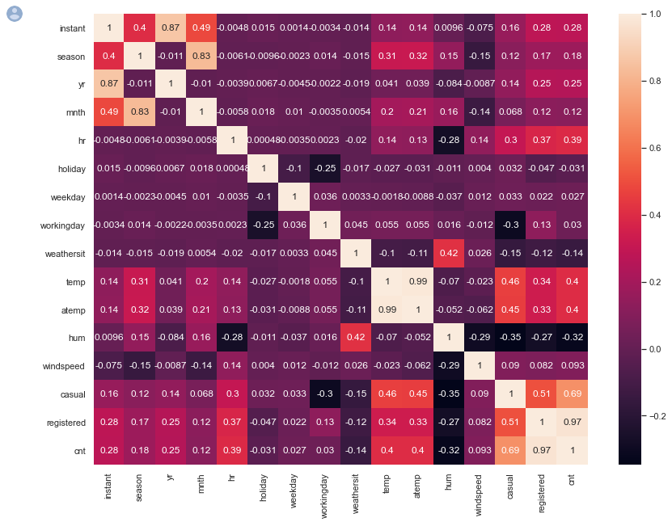
Correlation Matrix Breakdown
We can use the correlation matrix above to see the correlation among different variables in our dataset. The lighter the color, the stronger is the correlation.
Some of the highest correlations can be found between the registered users and their high rentals during the weekdays compared to the casual users who are highly correlated with the weekends, supporting the results of our previous analyses.

Slide 15
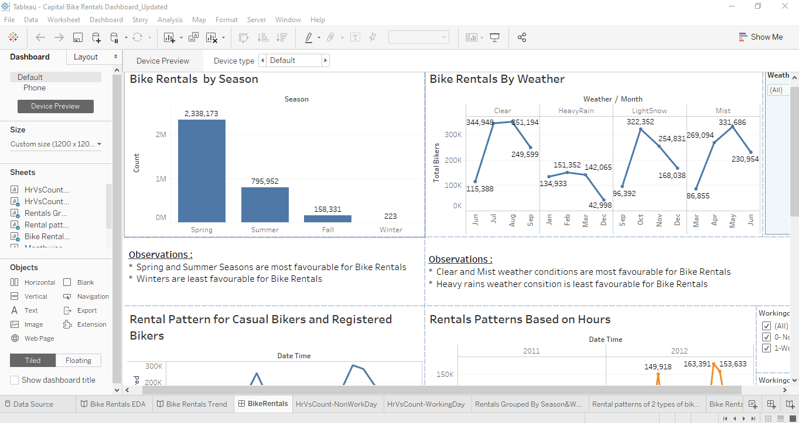
Dashboard

Slide 16
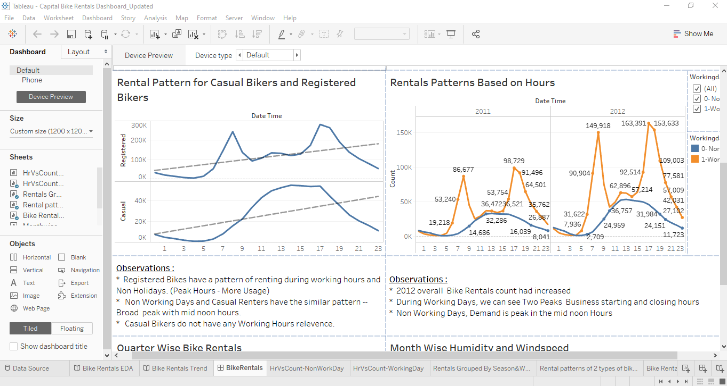
Dashboard

Slide 17
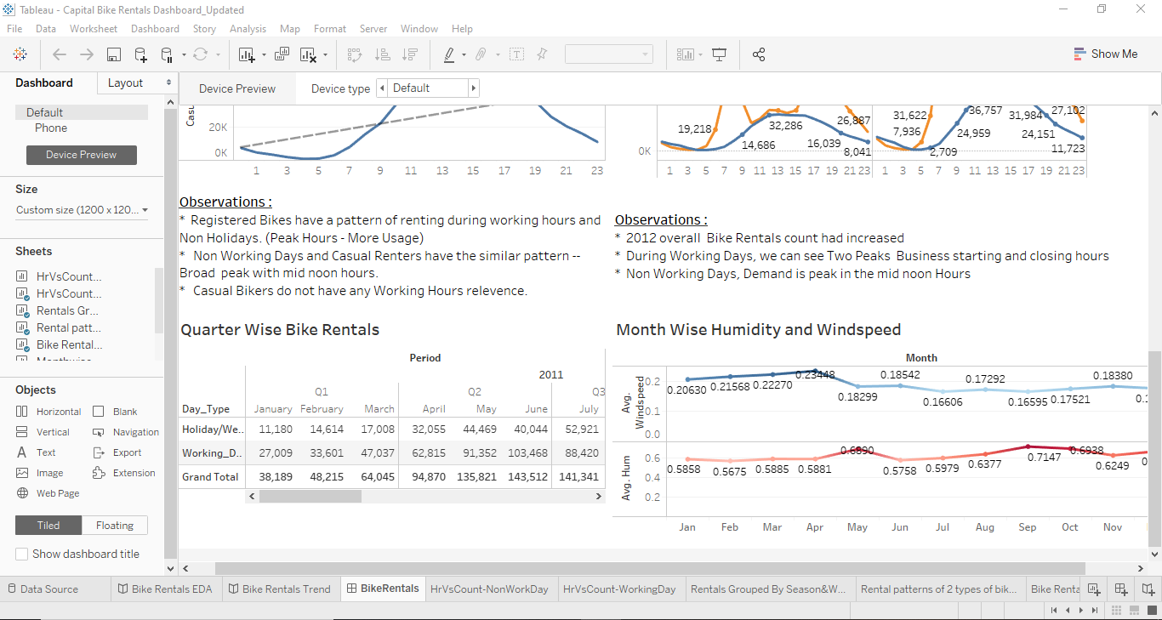
Dashboard

Slide 18
Model Formulation
We have created a regression model in order to predict the bike rentals on an hourly basis. Prior to constructing the model, the data is pre-processed in order to remove some of the attributes such as date and count of registered rentals and count of hourly rentals in order to determine all the other attributes that contribute in predicting the count of the bike rentals.
As a part of data preprocessing step attributes such as date, instant, number of casual bike renters, number of registered bike renters are removed from the dataset under analysis. This step is followed by splitting the data set into training and test sets and further grouped into dependent and independent variables.
This is followed by model construction. We are implementing a linear regression model. And the model is trained using the train datasets. This is followed by predicting the number of bike rentals using the variables available in the test dataset.

Slide 19
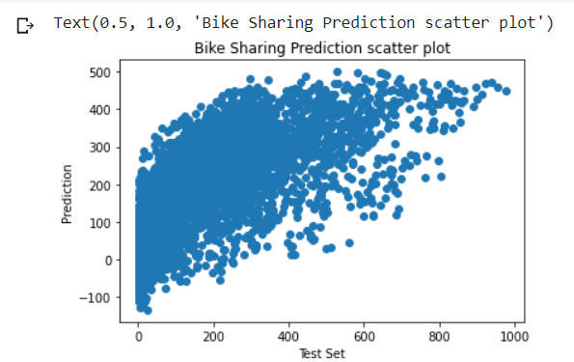
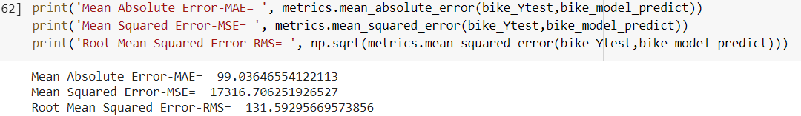
Bike Sharing Prediction Scatter Plot
From the plot we can see that the model has predicted a numerically higher number of bike rentals compared to the test set.
The next in this process is to determine the Mean Absolute Error, Mean Squared Error and Root Mean Squared error as shown below. This will help us validate our results.
Error Calculation
The smaller the root mean squared error, the closer we are to finding the line of best fit. However, the value of these metrics mainly depends upon the dataset under consideration. If the data are widely scattered as shown in the previous plot, the chances of root mean squared error being higher are more.

Slide 20
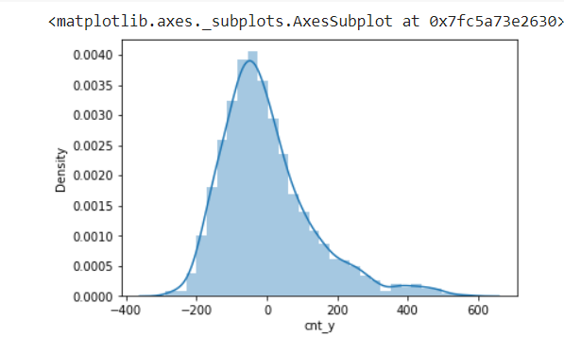
Density Plot of Bike Rental Distribution
Following is the density plot of the results of our analysis. Density plot provides a representation of the distribution of the count of bike rentals. The following density plot uses a kernel density estimate to show the probability density function of the bike rentals count variable

Slide 21
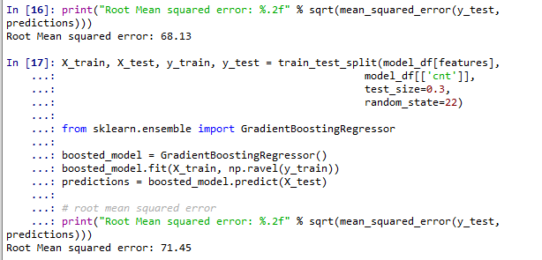
Non-Linear modeling using Gradient Boosting:
We can further improve the RMSE score by opting for a gradient boosting regressor after using dummy variables for our categorical ones.
The RMSE that we obtain using GBR is significantly lesser than the linear model, as it varies from 68 to 72 based on different proportions of the testing set used.

Slide 22
Time Series Analysis
We performed time series analysis using three different techniques.
Simple moving average
Weighted moving average
Exponential smoothing
The predictions were made of the following columns using the above methods
Number of casual users renting bikes per day
Number of registered users renting bikes per day and
Number of bike rentals per day

Slide 23
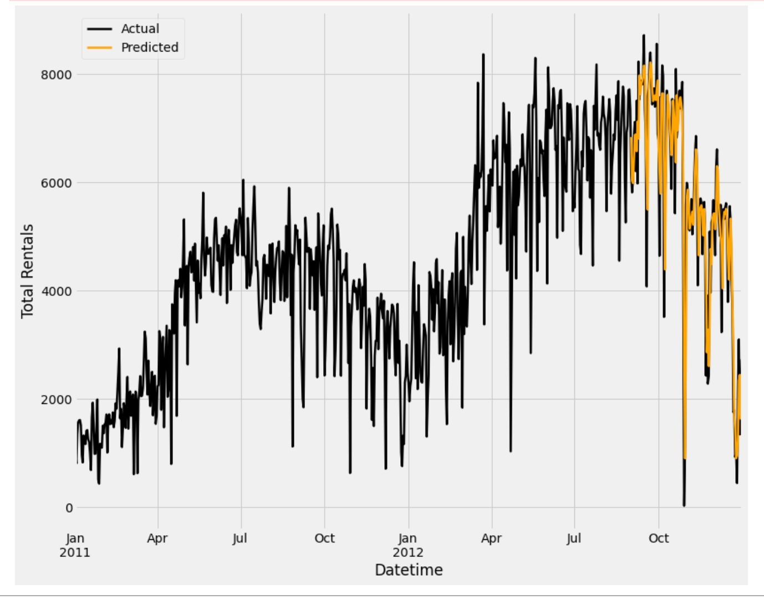
Prediction of total rentals per day
We have 2 years’ worth of data of which 18 months was used as training data and 6 months as testing data. When we ran the 3 months on the available data to predict the aforementioned columns, the most accurate method to predict turned out to be the Weighted moving average method. The prediction results when using the weighted moving average method is as follows
As we can see from the graph, the predicted rental totals is very close to the actual rentals.

Slide 24
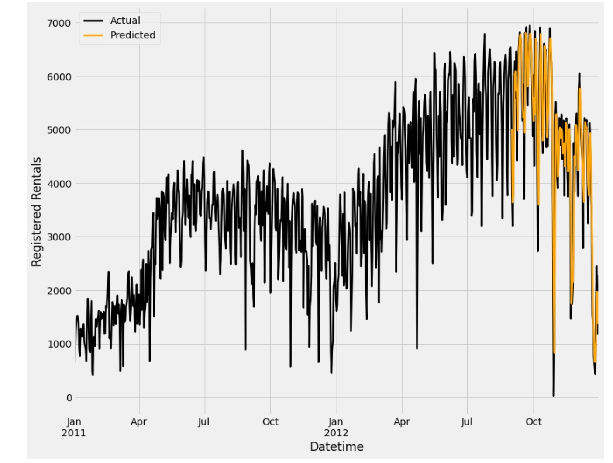
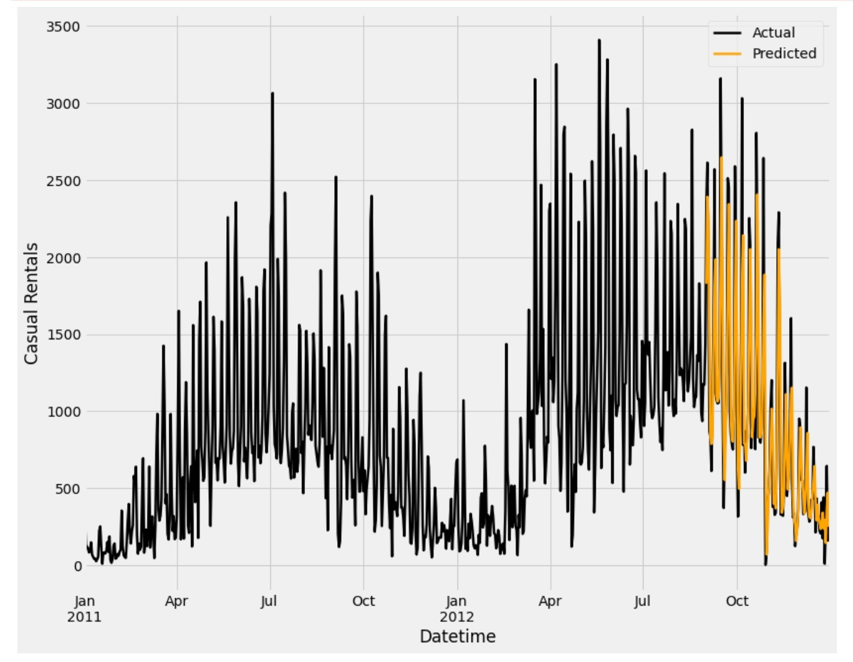
Prediction of Registered Rental Users per day
Prediction of Casual Rental Users per day

Slide 25
Conclusion
For the business questions raised earlier in the introduction section, we can answer them using our analysis results in the above sections as follows:
Should more money be invested in the bike sharing system with a good ROI chance?
Ans: Yes. The results above indicate that the trend in the bike sharing system is likely to go up and hence market for such system will go up too.
How should the maintenance be scheduled looking at the availability?
Ans: As per the results above, it would be advisable to consider winter season for all the maintenance work as other seasons are heavily preferred for bike renting.
Can the casual users be turned registered?
Ans. Marketing can be done based on the results above to attract specific users, be it casual or registered. However, the casual users can be given incentive to become registered based on their rental activity.
Can more people be encouraged and attracted to this bike sharing system?
Ans. The results indicate that if the weather conditions are favorable, more people can be attracted to try out the bike sharing systems, and they are likely to do so increasingly in the future. By specific marketing based on the data available, this can be sped up significantly.

Slide 26
References
Hadi Fanaee-T, UCI. (n.d.). Bike Sharing Dataset Data Set. Getting Started with Hadoop Tutorial. Retrieved from https://archive.ics.uci.edu/ml/datasets/bike+sharing+dataset#

Slide 27
Thank You

